Slide 1
Nonlinear ARX Identification
Presented by:
Pîțan Timeea 8/8
Suciu Sorina 8/8

Slide 2
Table of Contents:
Introduction
Implementation
Tuning Results
Conclusions

Slide 3
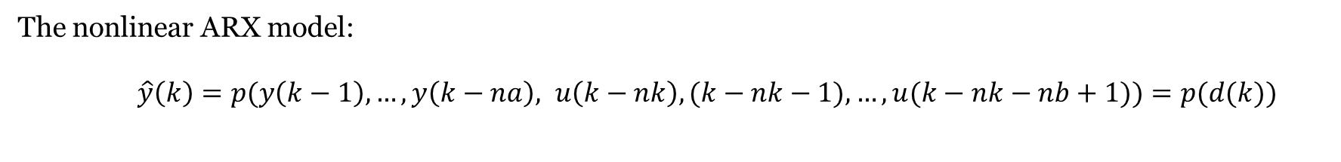
Introduction
About nonlinear ARX
The nonlinear ARX model:
$\hat{y}\left(k\right)=p(y\left(k−1\right), …, y\left(k−na\right), u\left(k−nk\right), (k−nk−1),…, u(k−nk−nb+1))=p(d(k))$
where $p$is a polynomial function and $d\left(k\right)$is the vector of delayed outputs and inputs:
$d\left(k\right)=[y\left(k−1\right), …, y\left(k−na\right), u\left(k−nk\right), u(k−nk−1),…, u(k−nk−nb+1)]^{T}$
$na, nb$ are the orders of the system, $nk$is the delay and $m$ will be the order of the polynomial function.

Slide 4
Introduction
Example of nonlinear ARX
If $na=1, nb=1, nk=1,$then $d(k)=[y\left(k−1\right), u\left(k−1\right)]^{T}$ and for $m=3,$ it results the following regressor line:
$Regressor_{line}= [$ 1, $ay\left(k−1\right), bu\left(k−1\right),$
$cy\left(k−1\right)u\left(k−1\right),$
$$dy{\left(k−1\right)}^{2}, fu{\left(k−1\right)}^{2},$$
$$gy\left(k−1\right)u{\left(k−1\right)}^{2}, hu\left(k−1\right)y{\left(k−1\right)}^{2},$$
$iy{\left(k−1\right)}^{3}, ju{\left(k−1\right)}^{3})$]
After computing the whole regressor matrix, the parameter vector, $θ$, can be found using $θ=Regressor_{matrix}\backslash y$.
$θ$ = [$a, b, c, …,j]$

Slide 5
Table of Contents:
Introduction
Implementation
Tuning Results
Conclusions

Slide 6
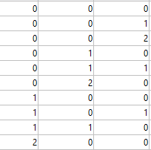
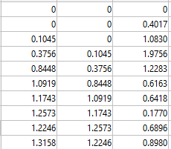
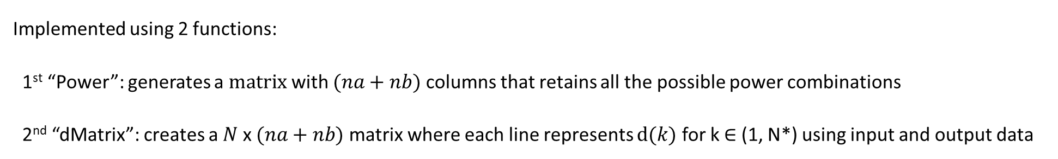
The Regressor Matrix
Implementation
Implemented using 2 functions:
1st “Power”: generates a$matrix$ with $(na+nb)$ columns that retains all the possible power combinations
2nd “dMatrix”: creates a $N$ x $(na+nb)$ matrix where each line represents $d(k)$ for k $∈$ (1, N*) using input and output data
Example: On the identification data, for $na=2, nb=nk=1 and m=2:$
Power matrix:
Dk will be a 801 x $na+nb$matrix:

Slide 7
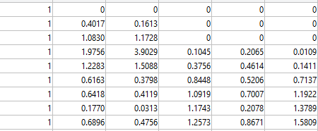
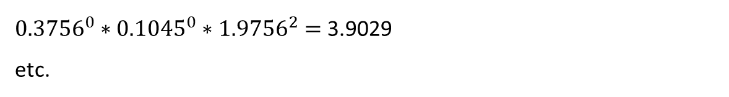

Implementation
The Regressor Matrix
Every row of the regressors matrix contains terms computed as products between every row of the dMatrix risen to all the combinations of powers given in the Powers matrix. If follows that each line of Dk risen to a combination of powers, will give one regressor element.
For the Dk line in red:
$${0.3756}^{0}∗{0.1045}^{0}∗{1.9756}^{0}=1$$
$${ 0.3756}^{0}∗{0.1045}^{0}∗{1.9756}^{1}=1.9756$$
${0.3756}^{0}∗{0.1045}^{0}∗{1.9756}^{2}=$3.9029
etc.

Slide 8

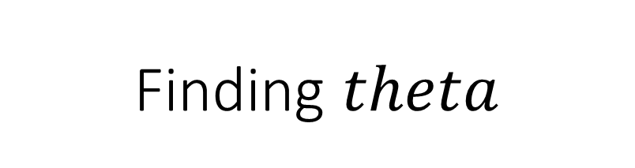


Finding $theta$
Implementation
$$θ=Regressor_{matrix}\backslash y_{id}$$
Finding $y_{pred}$
$y_{pred}=Regressor_{matrix}∗θ$

Slide 9
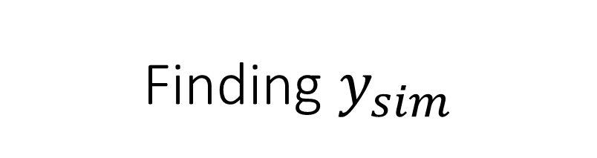
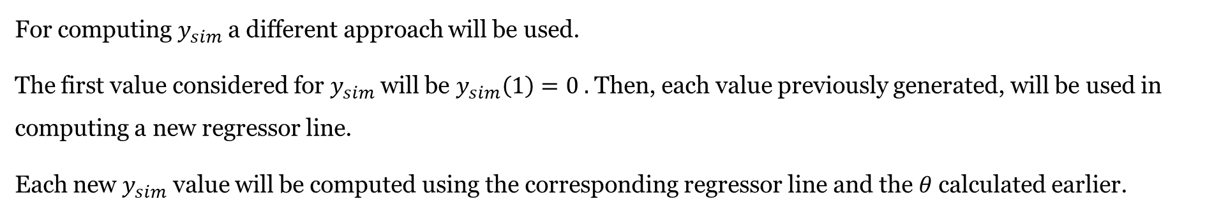
Implementation
Finding $y_{sim}$
For computing $y_{sim}$a different approach will be used.
The first value considered for $y_{sim}$will be $y_{sim}\left(1\right)=0 .$ Then, each value previously generated, will be used in computing a new regressor line.
Each new $y_{sim}$ value will be computed using the corresponding regressor line and the $θ$ calculated earlier.

Slide 10
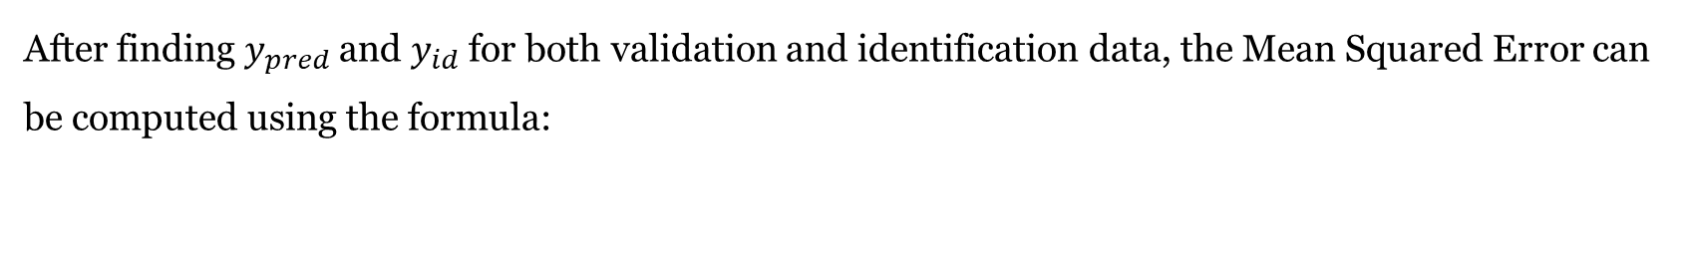

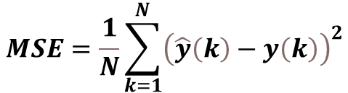
Implementation
Finding $MSE$
After finding $y_{pred}$ and $y_{id}$ for both validation and identification data, the Mean Squared Error can be computed using the formula:
$$MSE=\frac{1}{N}\sum_{k=1}^{N}{{\left(\hat{y}\left(k\right)−y\left(k\right)\right)}^{2}}$$
The corresponding Matlab function for the $MSE$ is called “MSE.m”.

Slide 11
Table of contents
Introduction
Implementation
Tuning Results
Conclusions

Slide 12

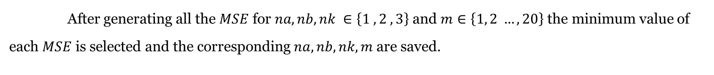
Plots for the best variables
Tuning Results
After generating all the $MSE$ for $na, nb, nk ∈\left\{1 ,2 ,3\right\}$ and $m∈\left\{1, 2 …, 20\right\}$ the minimum value of each $MSE$ is selected and the corresponding $na, nb, nk, m$ are saved.
Minimum $MSE ⇔$ best fit

Slide 13
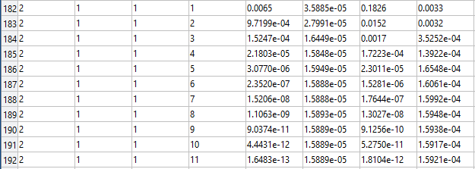
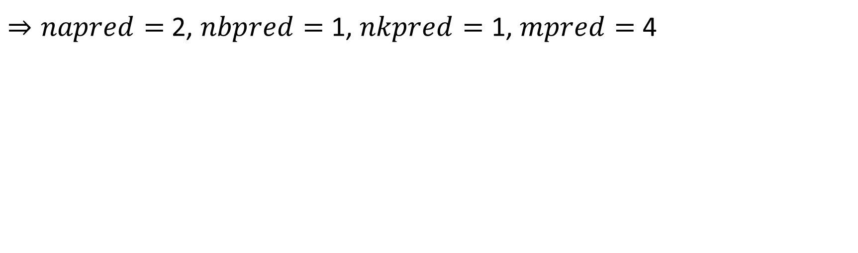
Best fit for $y_{pred}$
Tuning Results
The minimum $MSE$ for $y_{pred}$is equal to 1.5848e-05
$⇒napred=$2, $nbpred=$ 1, $nkpred=$ 1, $mpred=$ 4

Slide 14
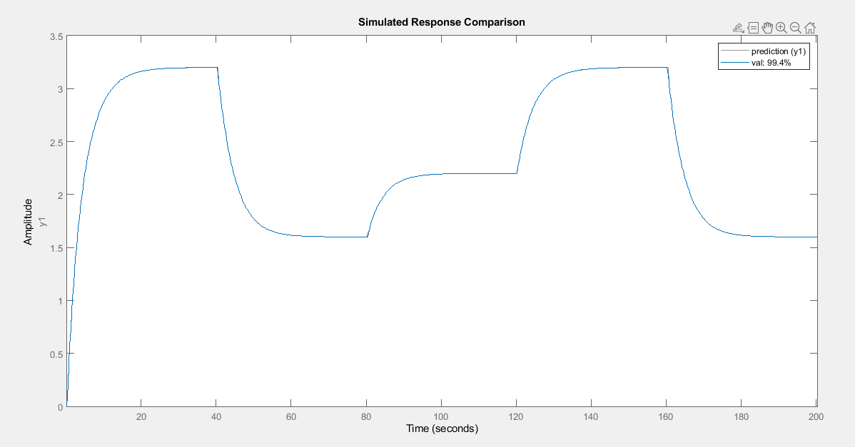


Plot for best fit - $y_{pred}$
$na=$2
$nb=$ 1
$nk=$ 1
$m=$ 4
$99,4\%$ is a good fit

Slide 15
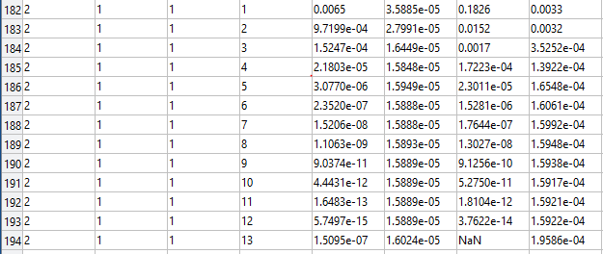
Best fit for $y_{sim}$
Tuning Results
The minimum $MSE$ for $y_{sim}$is equal to 1.3922e-04
$⇒nasim=$2, $nbsim=$ 1, $nksim=$ 1, $msim=$ 4

Slide 16
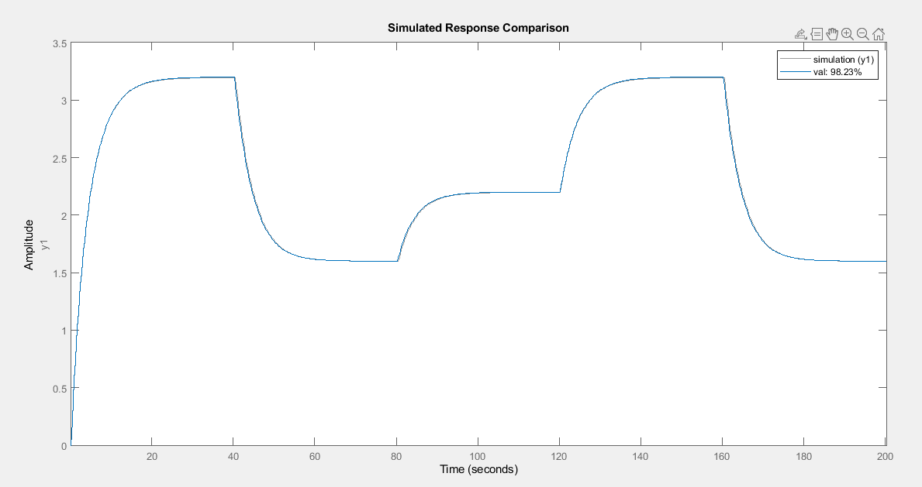


Plot for best fit - $y_{sim}$
$na=$2
$nb=$ 1
$nk=$ 1
$m=$ 4
$98,23\%$ is a good fit

Slide 17
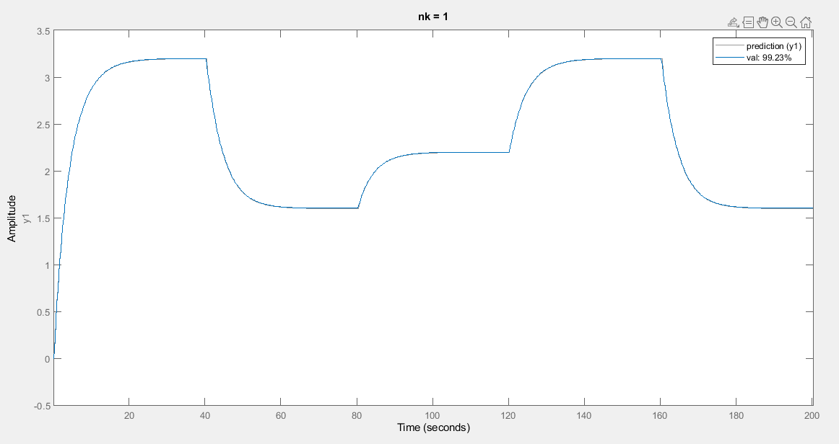

Tuning results when $nk$varies for $y_{pred}$
For $na=1$, $nb=$ 2, $m=$ 2, $nk=1$
$99,23\%$ is a good fit

Slide 18
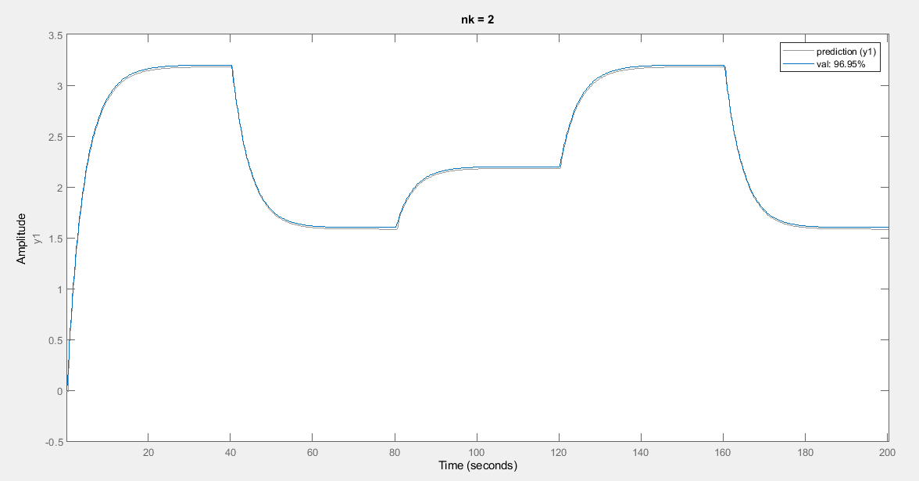
Tuning results when $nk$varies for $y_{pred}$
For $na=1$, $nb=$ 2, $m=$ 2, $nk=2$
$96,95\%$ is a bad fit

Slide 19
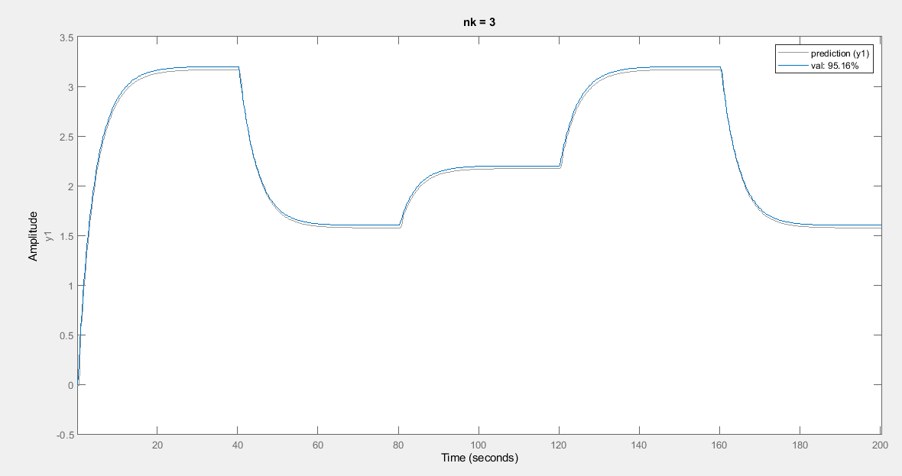
Tuning results when $nk$varies for $y_{pred}$
For $na=1$, $nb=$ 2, $m=$ 2, $nk=3$
$95,16\%$ is a bad fit

Slide 20
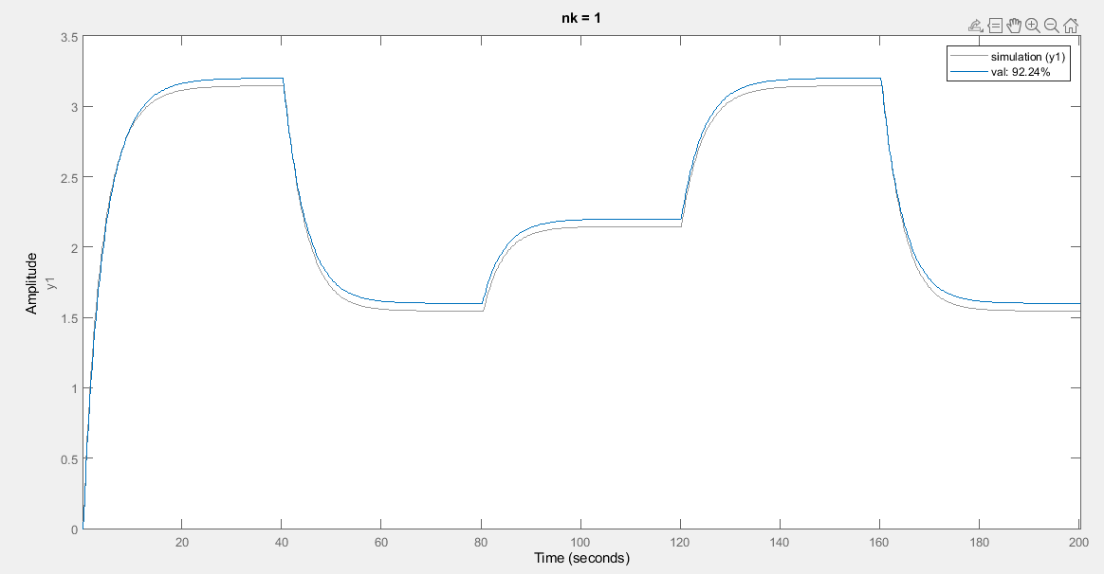
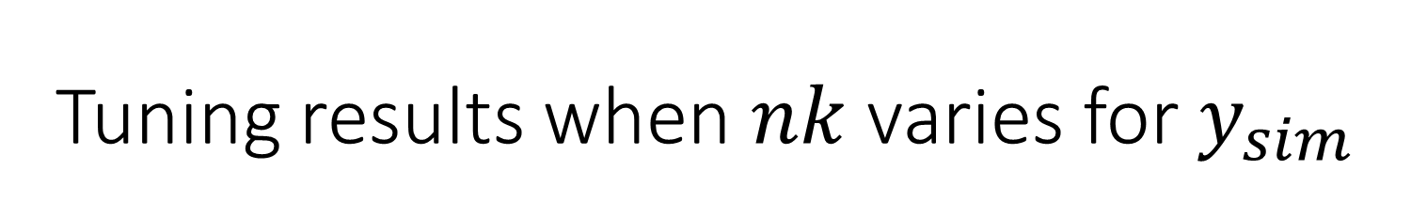
Tuning results when $nk$varies for $y_{sim}$
For $na=1$, $nb=$ 2, $m=$ 2, $nk=1$
$92,24\%$ is a pretty bad fit

Slide 21
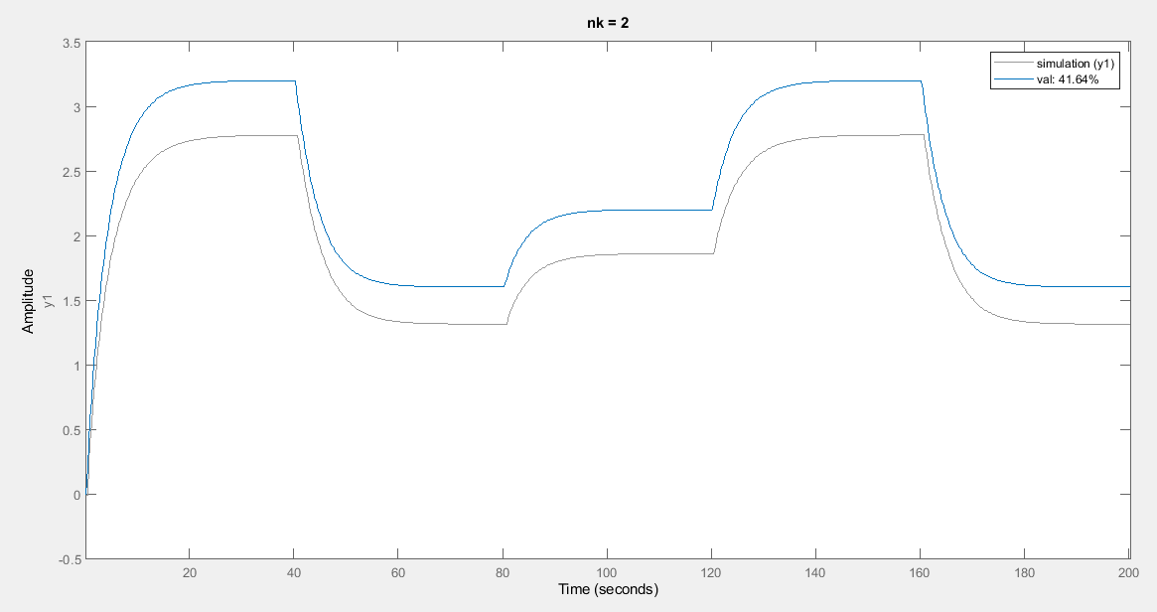
Tuning results when $nk$varies for $y_{sim}$
For $na=1$, $nb=$ 2, $m=$ 2, $nk=2$
41,64$\%$ is a bad fit

Slide 22
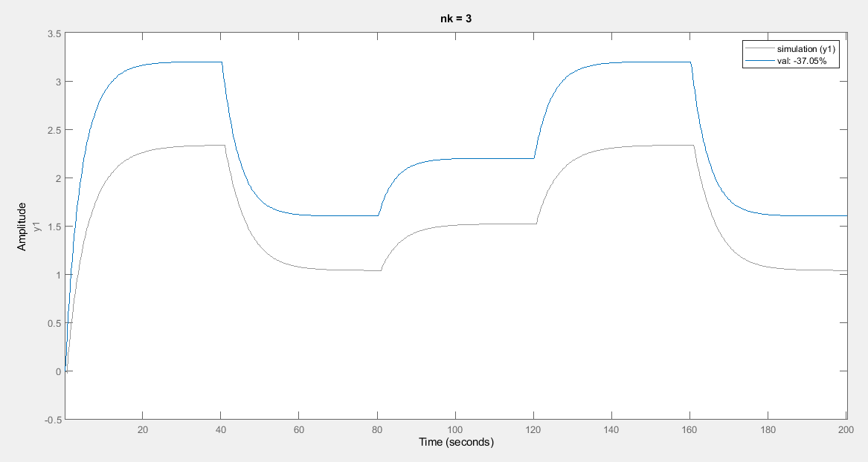
Tuning results when $nk$varies for $y_{sim}$
For $na=1$, $nb=$ 2, $m=$ 2, $nk=3$
-37$,16\%$ is a very bad fit

Slide 23
Table of contents
Introduction
Implementation
Tuning Results
Conclusions

Slide 24
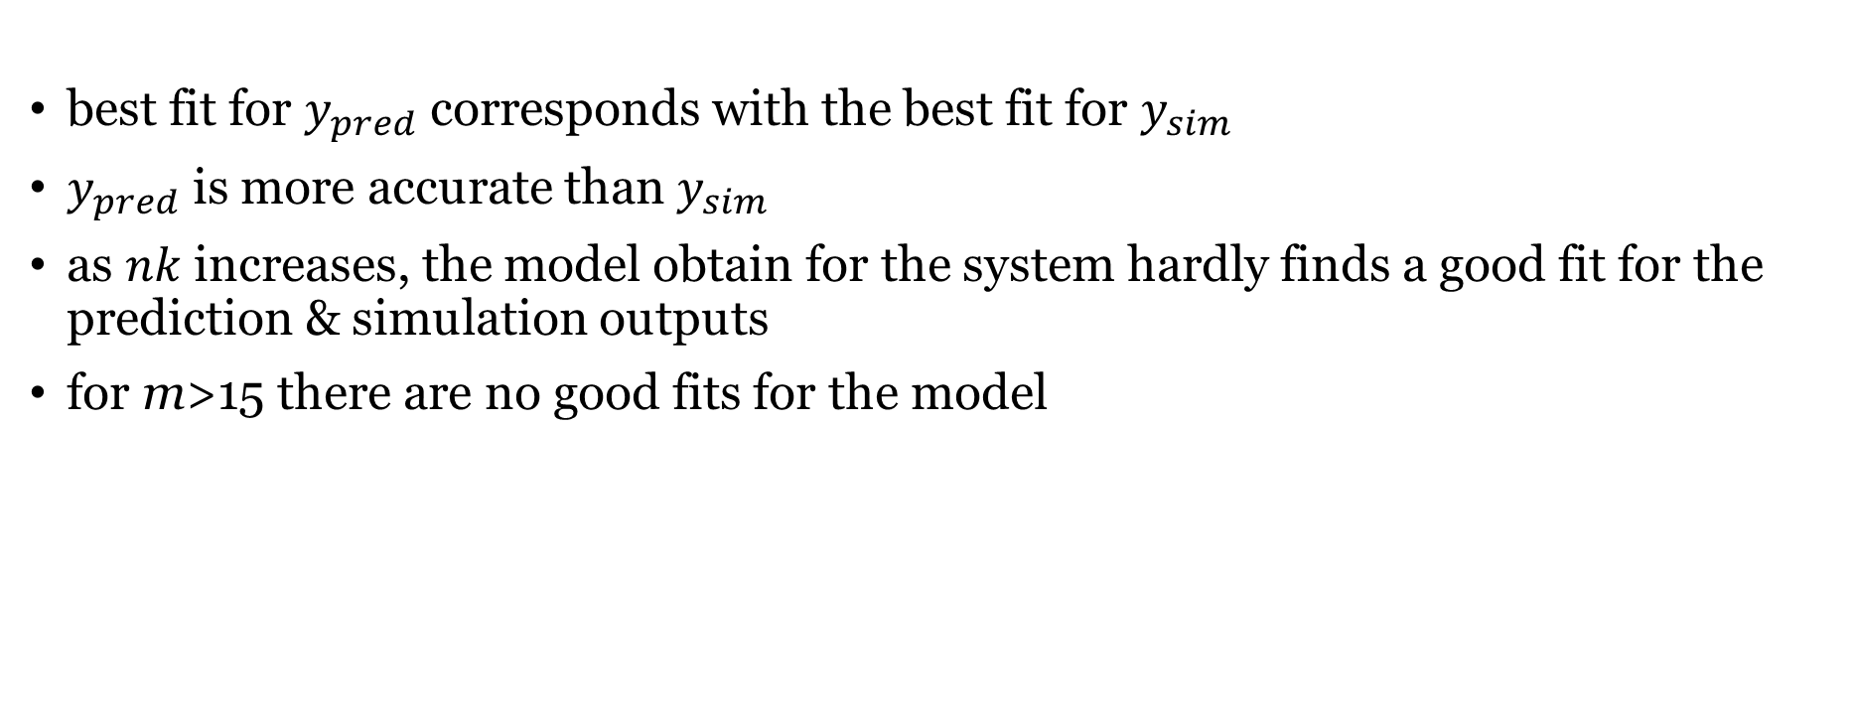
Conclusions
best fit for $y_{pred}$ corresponds with the best fit for $y_{sim }$
$y_{pred}$ is more accurate than $y_{sim }$
as $nk$increases, the model obtain for the system hardly finds a good fit for the prediction & simulation outputs
for m>15 there are no good fits for the model

